Slide 1
PROJECT GOLDPHISH
Phishing Awareness and Education
Monday Suami

Slide 2
OVERVIEW
Introduction to Phishing
Types of Phishing attacks
How does Phishing work?
Phishing Techniques
Recognizing Phishing Attempts
Protective Measures
Next Steps
Simulation/ Demonstration
Conclusion

Slide 3
What is Project GoldPhish?
Project GoldPhish is an initiative focused on educating individuals and organizations about the dangers of phishing attacks.

Slide 4
Presentation Objectives
1
2
3
To empower individuals and organizations to identify phishing attempts.
To teach proactive steps to prevent being victimized by phishing attacks.
To spread awareness about the potential personal and professional repercussions of falling for phishing schemes.

Slide 5
Introduction to Phishing
Phishing is a form of cyberattack where attackers pose as a legitimate entity in order to trick individuals into revealing sensitive information such as passwords, credit card numbers or personal identification details.
The term “Phishing” is derived from the attack’s closeness to actual “Fishing” as it is also involves the use of bait (lure email/ message) against a large group of internet users with the hopes that at least one would be gullible enough to fall victim.
It is an extremely effective attack and stands out from other forms of attacks because it exploits human nature, trust and psychology.

Slide 6
36% of data breaches in 2023 were caused by phishing attacks.
Security systems can be designed to be impenetrable but the human mind would always be susceptible to manipulation.

Slide 7

Types of Phishing Attacks
Email Phishing: This is the most common type of phishing. Attackers send mass emails that appear to come from legitimate sources, such as banks, social networks, or online services. These emails often contain malicious links or attachments to trick recipients into revealing sensitive information.

Slide 8

Types of Phishing Attacks
Spear Phishing: Unlike mass email phishing, spear phishing targets specific individuals or companies. Attackers conduct research on the target to make the messages more personalized and believable.
For example, they might impersonate a known contact or reference internal company details.

Slide 9
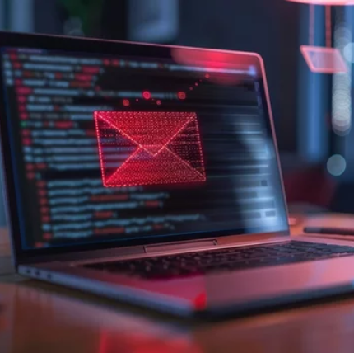
Types of Phishing Attacks
Whaling: Similar to spear phishing. Whaling targets only a particular category of individuals―high-profile executives or senior management (the "big fish") within organizations.
The emails or messages appear to come from a trusted source and often aim to authorize large financial transactions or release sensitive data.

Slide 10
Types of Phishing Attacks
Smishing (SMS Phishing): Smishing uses text messages to lure victims. Attackers often send messages that appear to be from banks, delivery services, or other trusted organizations, encouraging recipients to click on a link or call a phone number.
Vishing (Voice Phishing): In vishing, attackers use phone calls to pose as legitimate entities, such as banks, tax authorities, or tech support. They may request personal details, credit card information, or remote access to the victim’s computer.

Slide 11

How Phishing works: Anatomy of a Phishing Attack
The Bait (The Setup): At this stage, the phishers craft a convincing message, mimicking a trusted entity in order to guarantee target interaction.
These messages are usually sent as emails but it can also be sent through SMS or social media.
The messages are designed to play on human emotions like fear, curiosity, or urgency, with subjects like “Immediate action required!”, “Your account will be deactivated unless you verify your details!”

Slide 12

How Phishing works: Anatomy of a Phishing Attack
The Hook (Luring the Victim): The message typically contains a link or attachment that directs the user to a malicious website or downloads harmful software.
Attackers often use shortened URLs or domains that look similar to legitimate sites to disguise their true intentions.
Hooks may look like: “Click here to update your payment information”, “Download this document to verify your account”

Slide 13
How Phishing works: Anatomy of a Phishing Attack
The Catch (Executing the Attack): This is the stage where the user interacts with the content, either by clicking the link or opening the attachment.
What follows next is usually one of two things: Either the user is directed to a fake website prompting them to enter sensitive information such as Usernames, Passwords or Card Details.
Or the user interaction prompts an automatic malware to be installed on the device, allowing attackers to take control of the system.
The Steal (Exploiting the Data): At this stage, attackers may use the obtained information for financial gain or unauthorized access to other systems leading to data breaches.

Slide 14
Phishing Techniques
URL Spoofing:
Domain Tricks:
Design Copying:
Fake Websites
Attackers create websites that closely resemble legitimate sites, such as banking portals, online stores, or social media platforms. The goal is to trick users into entering sensitive information.
Attackers use URLs that look nearly identical to legitimate sites, changing just one letter or using characters that resemble each other (e.g., “rn” instead of “m”).
Phishers use domains like .co instead of .com or add words to make the site look official.
They replicate the design, layout, and even images from the original site to make it look as convincing as possible.

Slide 15
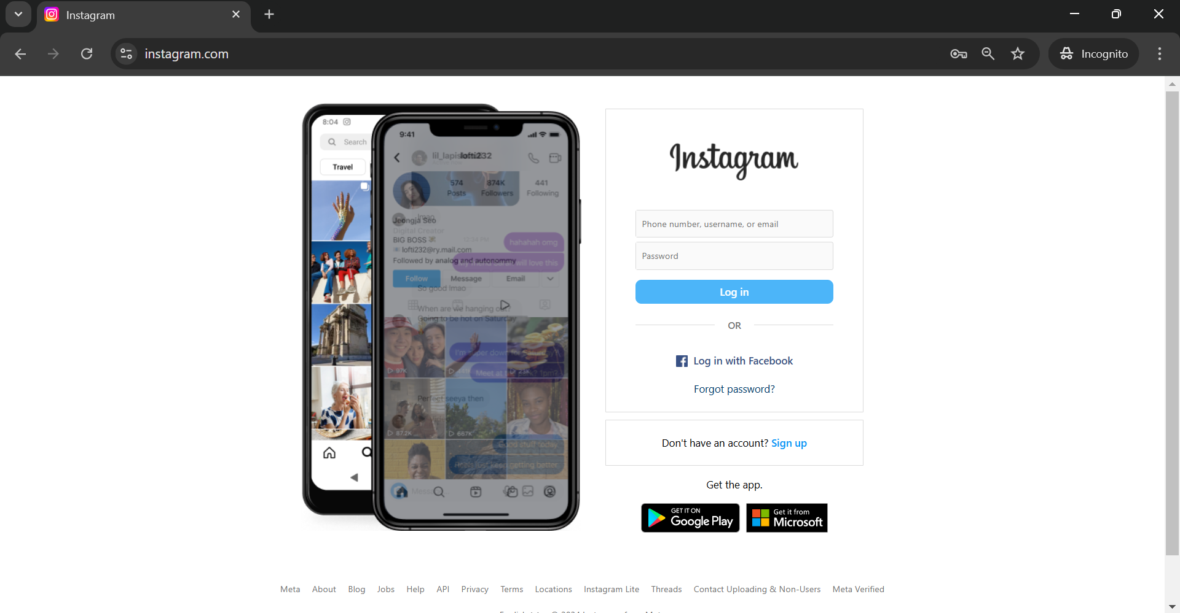
Phishing Techniques
Original Website

Slide 16
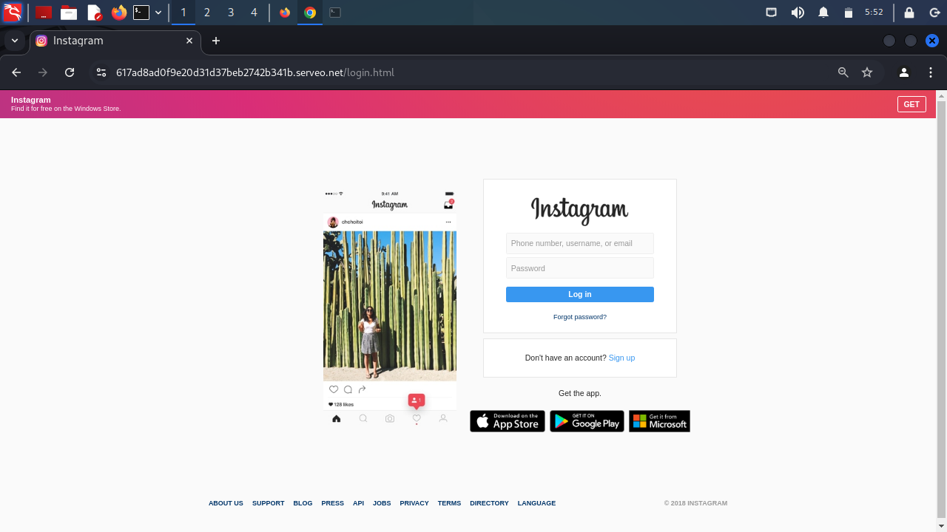
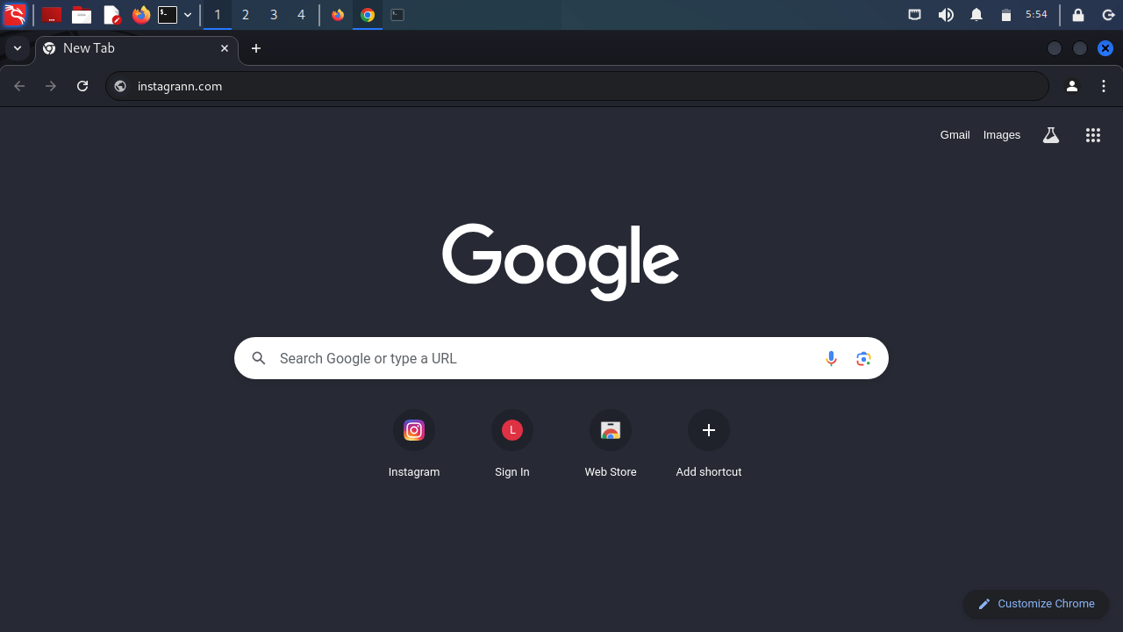
Phishing Techniques
Phishing Website
Url spoofing
Domain tricks
Design copying

Slide 17
Phishing Techniques
Ransomware:
Keyloggers:
Spyware:
Attachments with Malware
Phishers often include attachments in emails or messages, claiming they contain important documents like invoices, contracts, or even rewards. These attachments, when opened, install malware on the user's device.
Encrypts files on the victim’s device and demands payment for their release.
Track and record every keystroke made by the user, capturing sensitive information like passwords and credit card numbers.
Gathers information from the device and sends it to the attacker.

Slide 18
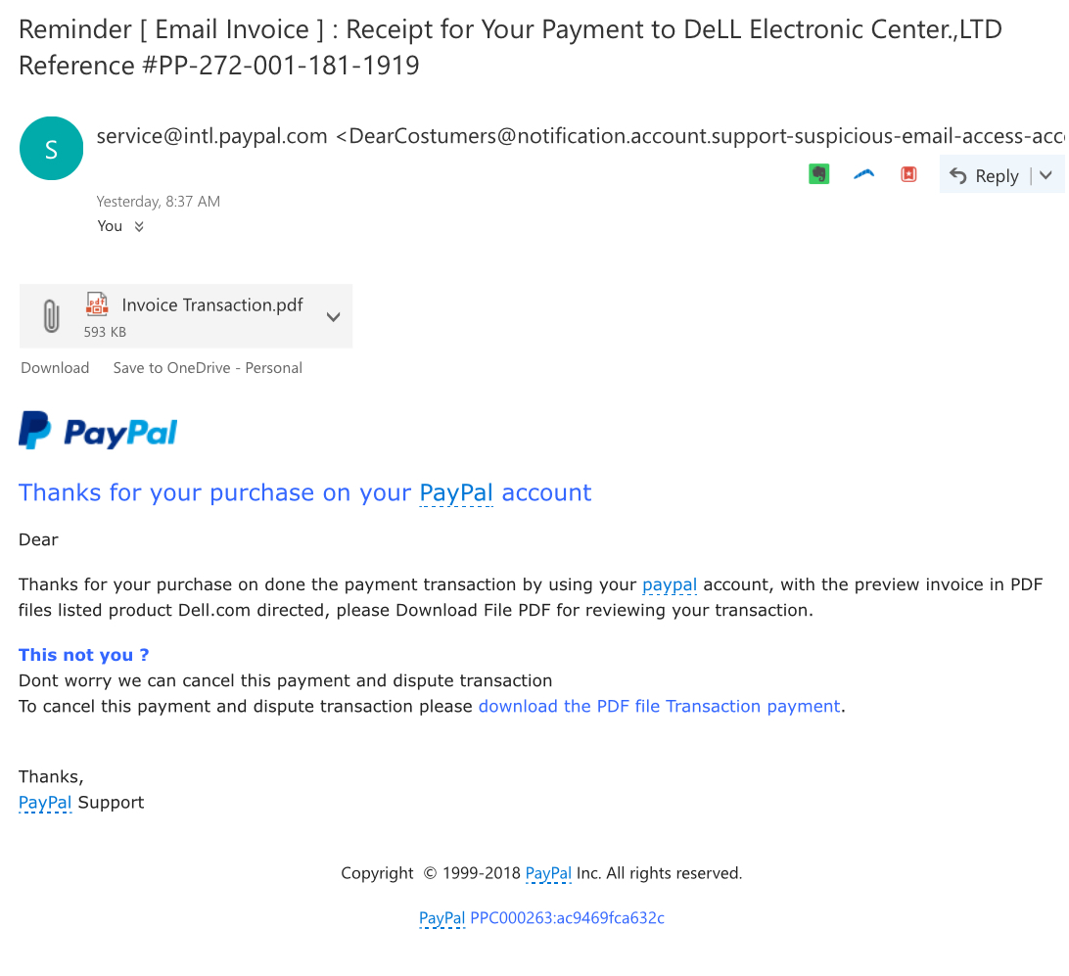
Phishing Techniques
Phishing Email
Misspelling
Malicious attachment
Generic greeting
Continuous emphasis on downloading the attachment

Slide 19
Phishing Techniques
Authority:
Urgency/ Fear:
Curiosity/ Reward:
Social Engineering
Social engineering in phishing involves manipulating people into divulging confidential information or performing actions against their best interests by exploiting human psychology.
Pretending to be a person of authority (e.g., a company executive or IT administrator) to make requests seem legitimate
Creating a false sense of urgency to make users act quickly and skip careful checks. Also, fear of consequences, such as account suspension, to pressure victims into complying
Offering something desirable, like a prize or bonus, to motivate users to engage with the phishing attempt.

Slide 20
Recognizing Phishing Attempts
Spelling and Grammatical Errors
Urgent/ Threatening Language
Mismatched/ Suspicious sender address
Legitimate emails are unlikely to contain spelling or grammatical mistakes.
Phrases like “Act now,” “Immediate action required,” or “Your account will be locked!”
Addresses may have minor variations, such as extra characters, misspellings, or using free domains

Slide 21
Recognizing Phishing Attempts
Links that redirect to Fake websites
Requests for Personal information
Generic/ Unusual Greetings
Links look like they lead to a legitimate website but actually direct to a fake or malicious site.
Legitimate organizations rarely, if ever, ask for sensitive information
Phishing emails often use generic greetings like “Dear Customer”,“Hello User” instead of the recipient’s name

Slide 22
Be Wary of “Too Good to Be True” Offers
Offers that seem unrealistic, like winning a prize without participating, are likely phishing attempts.

Slide 23

Protective Measures
Phishers are smart, but you can be smarter. Here’s how you can stay safe
Verify Send information Carefully: Pay attention to the subtle details; Examine the email address and urls for misspellings, extra characters and non standard domains.
Some attackers might pose as a known contact. If something feels off, confirm directly with the sender through another contact method.
Cross-check on official websites. If in doubt, go to the organization’s official website and contact their support team for verification.

Slide 24
Protective Measures
Avoid Clicking on Unknown Links and Downloading Attachments from Suspicious Emails: Always hover over links before clicking to see the full URL. Look for signs like strange characters, excessive numbers, or shortened URLs.
If you receive an unexpected attachment, verify with the sender before downloading.
Again, its the tiny details. Be wary of URLs that use common substitutions, like “paypa1.com” instead of “paypal.com” or “amaz0n.net” instead of “amazon.com.”

Slide 25
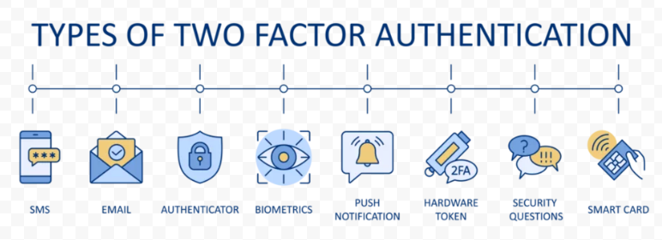
Protective Measures
Enable Multi-Factor Authentication (MFA) for an Extra Layer of Security: MFA adds an additional step to the login process, requiring not just a password but also a second factor, such as a code sent to a phone or generated by an authentication app. This makes it much harder for attackers to access accounts, even if they have a stolen password.

Slide 26
Next Steps?
Do not respond to the message
Do not forward the email
Report the email/ message to IT/ Security teams
Change your password immediately if you have clicked or entered information
Run a security scan on your device
So you figured it out, now what?

Slide 27
Demonstration
Live Simulation of a Phishing attack

Slide 28
These might be useful…
http://www.apwg.org/
http://www.cisa.gov/
reportfraud.ftc.gov
http://www.ic3.gov/
https://www.proofpoint.com/
https://www.mimecast.com/
https://www.mcafee.com/
https://www.avira.com/
https://1password.com/
https://www.dashlane.com/

Slide 29
CONCLUSION
Be Aware: Recognizing the tactics and signs of phishing is critical to preventing attacks
Be Skeptical and Verify: Don’t trust unsolicited messages without verification. Always verify any request for sensitive information directly with the source.
Use MFA: Layered security tools and regular updates are essential in minimizing risks.
Report Suspicions: Reporting potential phishing attacks helps others and enhances the overall security of your organization or community.
Think Before You Click – Your Data and Safety Depend on It.

Slide 30
THANK YOU FOR LISTENING TO THIS PRESENTATION
Presenter: Monday Suami
suamimonday@gmail.com
Linkedin
Github

